Slide 1
Notes:
Beverly

Slide 2
Notes:
Beverly

Slide 3
Notes:
Beverly

Slide 4
Notes:
Beverly -

Slide 5
Notes:
The Diversity Collaborative (DC) is committed to creating and sustaining a more diverse, inclusive, equitable, and just international school community through our focus on leadership.

Slide 7
Notes:
Anna - will switch to a live update to go over the site

Slide 8
Notes:
Daniel - brief intro

Slide 9
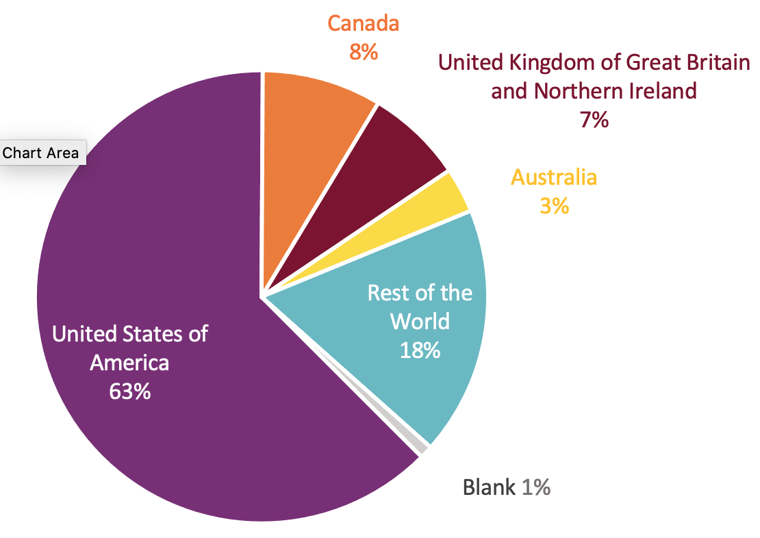
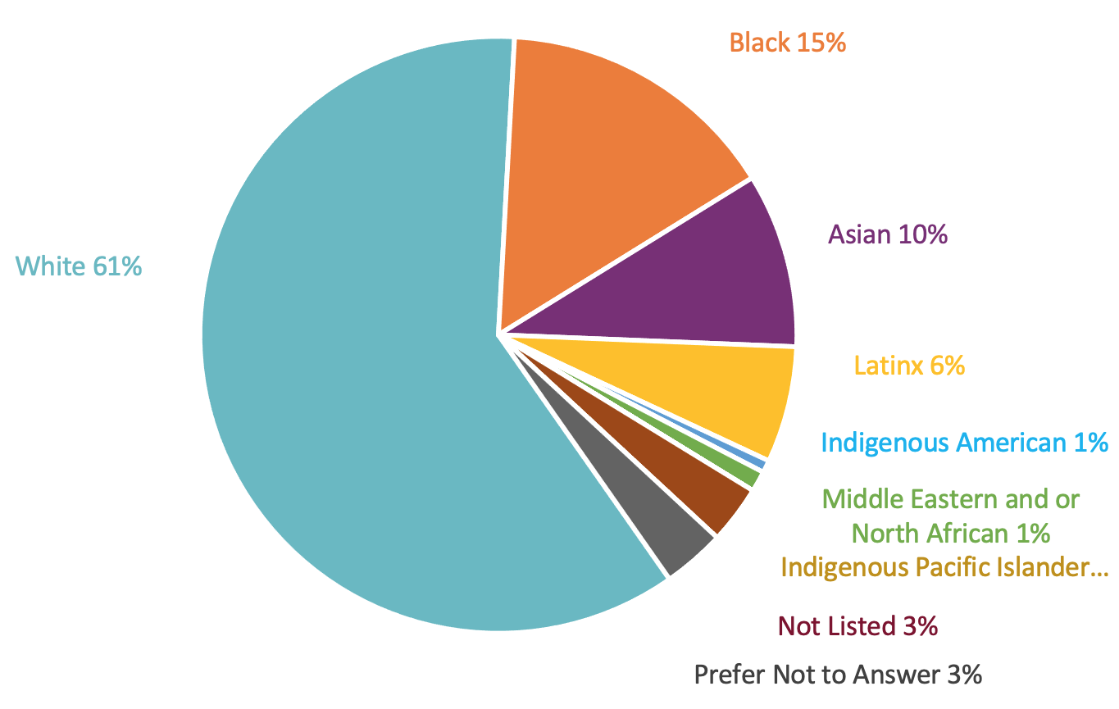
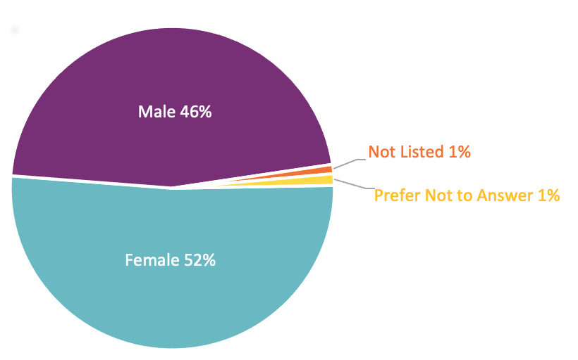
Race
Nationality
Gender
Notes:
Dana - As you can see from the demographic data, our colleagues who completed this survey mirror the current population of many of our international schools.
Race Demographics:
62% of our survey participants identified as white
15% Black
10 Asian
6% Latinx
Nationality
63% USA
8% Canada, 7% UK & Northern Ireland, 3% Australia
18% the rest of the world
Gender
46% male
52% female

Slide 10
Notes:
Alysa

Slide 11
Notes:
Daniel

Slide 12
Notes:
Dana - When we look at the perception of gender in the search process and treatment, there were a few significant findings.
In regards to aspects that positively impacted a person’s search for a leadership position, 29% of males indicated that their gender POSITIVELY impacted them. Additionally similar findings were found among males with 30% indicating that their gender POSITIVELY impacted their treatment as a leader.
47% of females indicated that their gender NEGATIVELY impacted their search for leadership compared to 9% of males
And 51% of females indicated that their gender NEGATIVELY impacted their treatment as a leader compared to only 10% of males.
So what does all this mean?

Slide 13
Notes:
Alysa - discussion of the 11 overall recommendations that have come from the report - intro how we will focus on three that speak to us

Slide 14
Notes:
Daniel

Slide 15
Notes:
Dana - Within our recommendations for professional development, training is required for recruiters to reduce bias, and validate multiple identities and perspectives during the hiring process. This training needs to include not just recruiters, but also leaders, board members, & search committees. Mind you - this is not a one and done type of training. It needs to be ongoing to become sustainable within our systems and structures of hiring practices.

Slide 16
Notes:
Alysa (when you are done, can you intro the Advocacy committee)

Slide 17
Notes:
Hanadi & Nadine

Slide 18
Growth Continuum
5
SUSTAINABLE DEVELOPED PRACTICES
Demonstrating continued growth in DEIJ and research-based practices, policies and systems
4
PROGRESSIVE
Diversity by design, equity audits, inclusivity and restorative practices are implemented and reflected upon; outcomes are imbedded into the institutions’ growth, strategic and performance goals.
3
PROACTIVE
The institution and its leadership (Board, Head, SLT) have a clear awareness of the value of DEIJ; has systematically begun examining, identifying and dismantling white supremacy culture.
2
REACTIVE
Compliance-only mindset. The institution has begun DEIJ work in a response to stakeholders.
1
INACTIVE
Diversity, equity, inclusivity and justice (DEIJ)work have not begun or are not part of the institutions’ goals.
Notes:
Nadine

Slide 19
Notes:
Hanadi

Slide 20
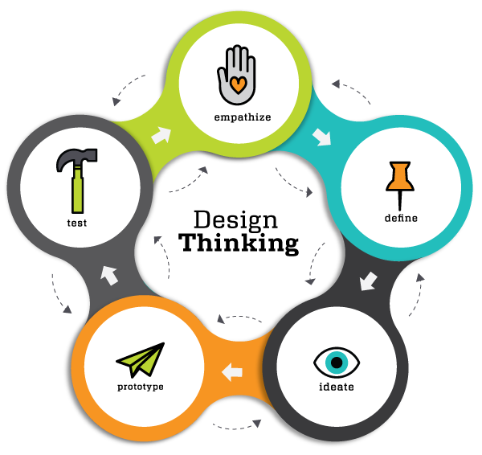
Inquiry-based
&
Impact-inspired approach
Notes:
Nadine

Slide 21
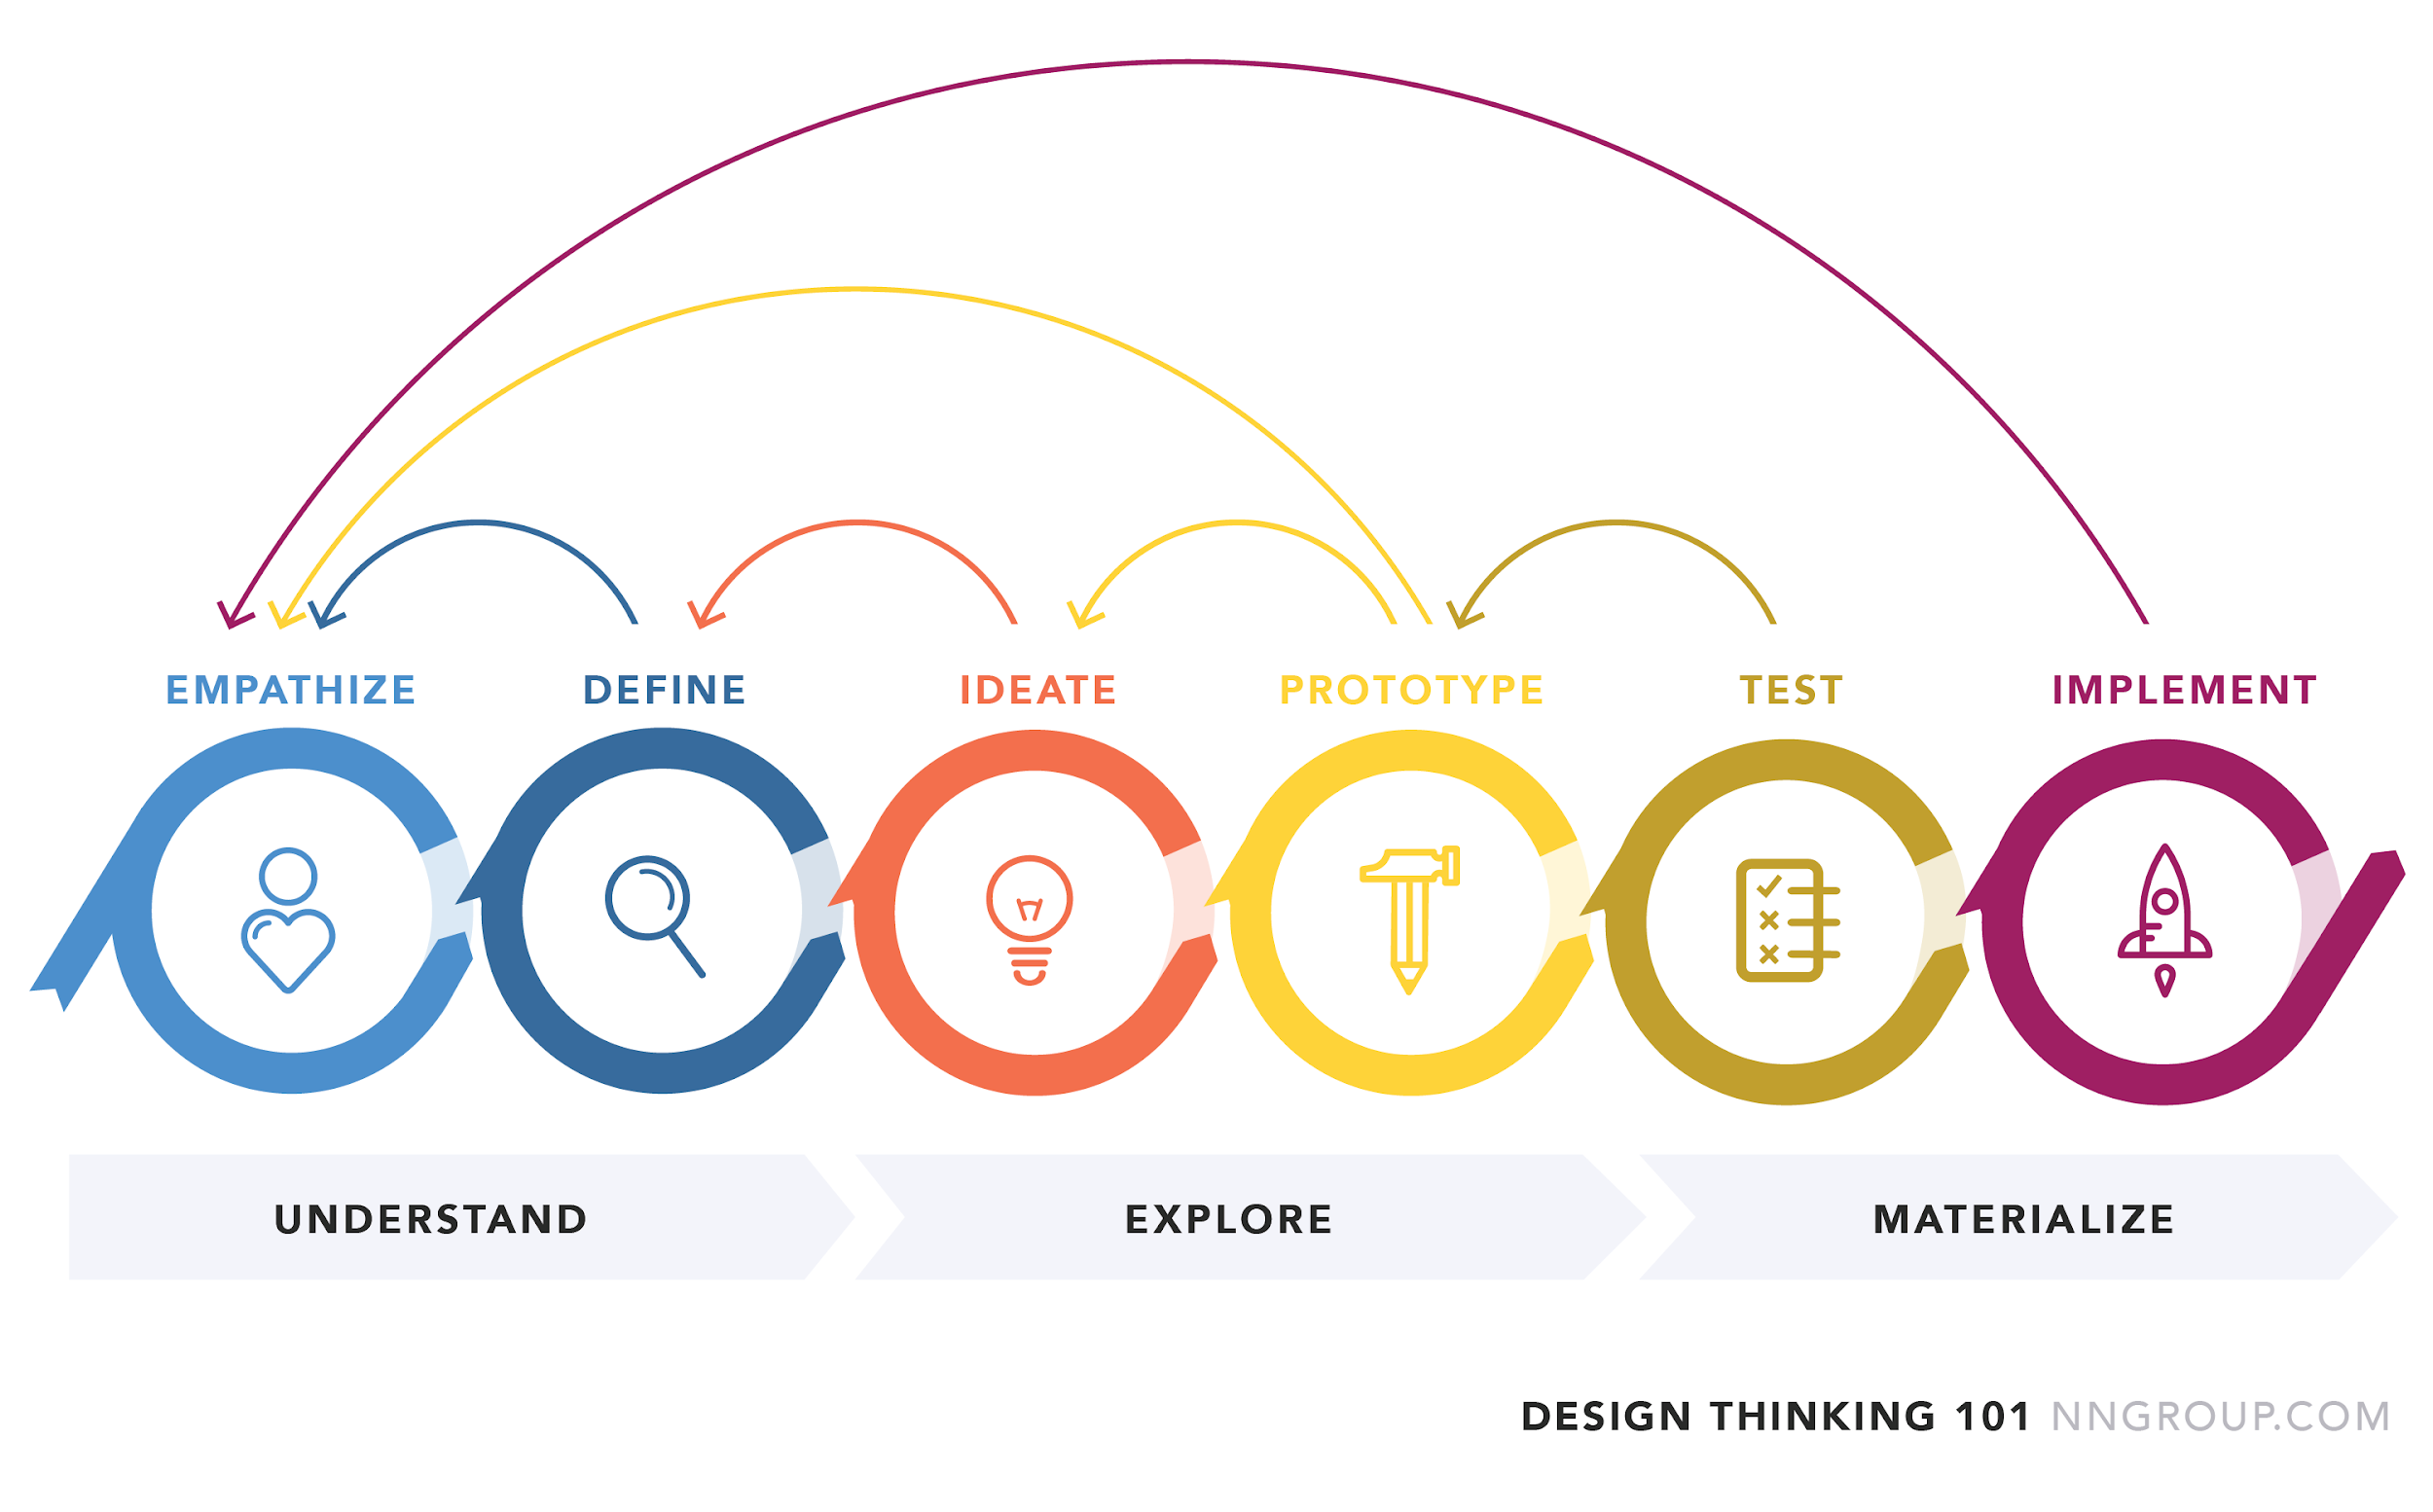
Explored challenges from the human context -- OKRs developed
Started with the “Why”
Research, define and understand diverse POV --Task Force Groups
Brainstormed ideas
Developed Action Plan
Subcommittees prototyping
Culturally Responsive Recruiting Habits of Mind & Heart (i.e badges, training)
Racism Safeguarding and Reporting Systems
Show don’t just tell
BIPOC (host Country locals) Paid Internship Program
Implementing BIPOC Aspiring Leaders Program
Developing DEIJ Sustainable Development Goals (DEIJ-SDG)
Whiteness Accountability Ally Group
Notes:
Hanadi & Nadine

Slide 22
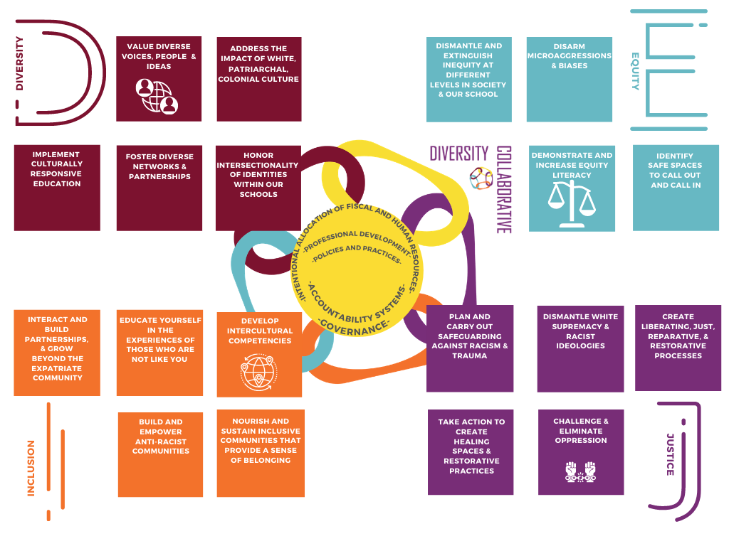
Please note:
This is a DRAFT copy
Notes:
Nadine

Slide 23
Dare to Lead: Be a Pathfinder!
Dare to Lead:
Be a Pathfinder!
Culturally Responsive Recruiting Habits of Heart & Mind
Host Country Locals (BIPOC) Internship Program
BIPOC Mentorship Program (AIELOC)
Notes:
Hanadi (first 2) & Nadine (last one)

Slide 24
Engagement Opportunities
Sponsorship Program: Expanding the Leadership Pipeline
Racism Trauma Safeguarding and Reporting System
Notes:
Nadine

Slide 25
ALLIES not BYSTANDERS
Seeking Courageous Leaders to Engage and Implement
Notes:
Nadine

Slide 26
Growth Continuum
5
SUSTAINABLE DEVELOPED PRACTICES
Demonstrating continued growth in DEIJ and research-based practices, policies and systems
4
PROGRESSIVE
Diversity by design, equity audits, inclusivity and restorative practices are implemented and reflected upon; outcomes are imbedded into the institutions’ growth, strategic and performance goals.
3
PROACTIVE
The institution and its leadership (Board, Head, SLT) have a clear awareness of the value of DEIJ; has systematically begun examining, identifying and dismantling white supremacy culture.
2
REACTIVE
Compliance-only mindset. The institution has begun DEIJ work in a response to stakeholders.
1
INACTIVE
Diversity, equity, inclusivity and justice (DEIJ)work have not begun or are not part of the institutions’ goals.
Notes:
Hanadi

Slide 27
“Not everything that is faced can be changed, but nothing can be changed until it is faced.” ~James Baldwin
“You can't go back and change the beginning but you can start where you are and change the ending.” ~ C.S. Lewis
"When you see something that is not right, not fair, not just, you have to speak up. You have to say something; you have to do something." ~John Lewis on seeking truth, justice, and equality, during the impeachment trial for US President Donald Trump
Notes:
Hanadi & Nadine

Slide 28
Notes:
Jennifer

Slide 29
Notes:
Jennifer

Slide 30
Notes:
Jennifer

Slide 31
Notes:
Jennifer

